Slide 1

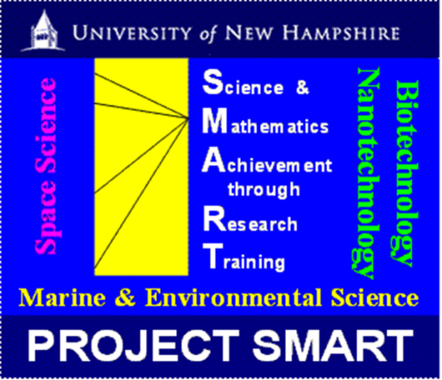
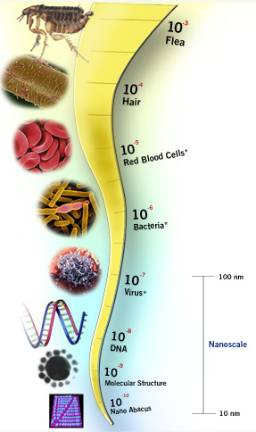
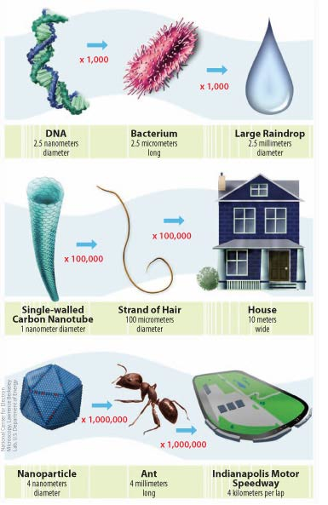
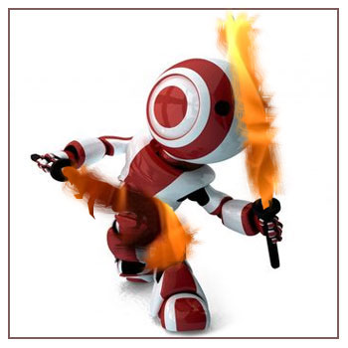
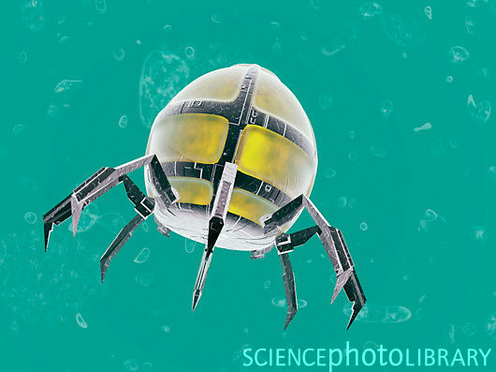
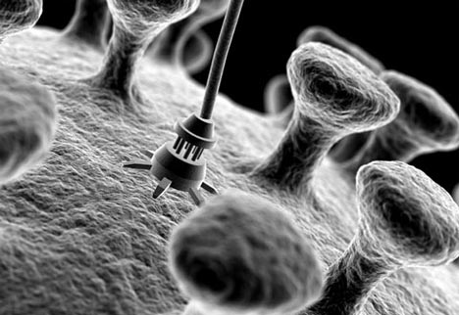
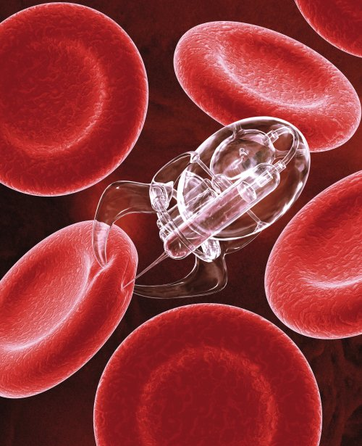
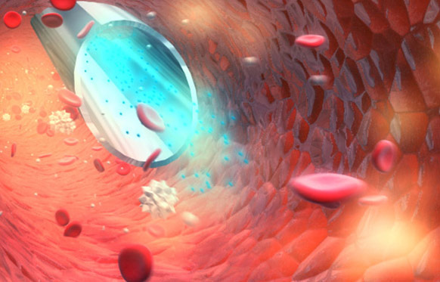
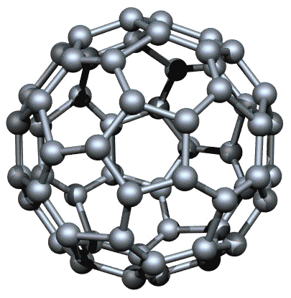
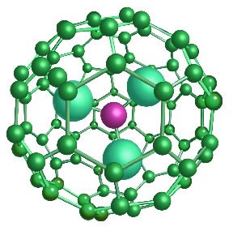
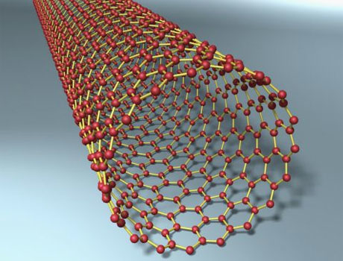
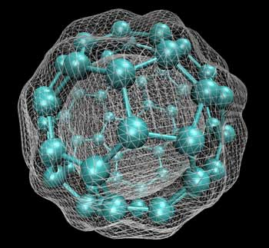

MILESTONE APP
By Arjun Bhatnagar
North Andover, MA
The Governor’s Academy
ABSTRACT:
HOW LARGE IS THE NANOSCALE?
THE FUTURE:
Despite the power of the immune system that fights off harmful bacteria and diseases each day, it seems even the simplest of colds can keep people from working. Deadly viruses such as AIDS have been studied for over 30 years and very little research has been found to cure it. Even though AIDS is able to completely elude the immune system ^{[1]} and cause great havoc, simple things such as colds, clogged arteries, and places such as the prostate gland where the immune system does not travel. The small mistakes that the powerful immune system makes can be highly dangerous to both one’s health and daily life.
Experimental technology in the field of nanotechnology and nanorobotics may be the potential cure we are looking for. Nanoscale robots in partnership with nanoparticles are able to detect and fight certain diseases and through future research it may be possible to provide a completely new immune system to patients with AIDS or similar threats.
The use of C60 and modified fullerenes has provided the capability of locating certain diseases and pathogens while also delivering particles that can fight infectious cells. If nanorobots were able to coordinate fullerenes, carbon nanotubes, and plasmid insertion then it would be possible to produce a more comprehensive immune system that could recognize infections and deliver a cure or kill an infection.
The future of our medicine and our technology lies in nanotechnology. With every step made, problems like AIDS, cancer, blood clotting, influenza, etc. will be easily solvable through nanobots that target and eliminate all the infected cells at an early stage.
The bots would be able to access a genome database and be able to recognize if cellular structures are good for the body or not.
Parts of the body that the immune system does not reach causes harmful consequences such as prostate cancer, but these nanoparticles and bots would be able to travel and maintain stability everywhere.
Common pathogens and viruses such as the cold would be dealt with immediately before it could spread throughout the body. This would save the people who lose work hours due to illness.
The nanobots could be used to alter DNA sequences of cells through plasma insertion so it could be possible to perform genetic engineering from the inside.
As fat is stored in a layer of “fatty cells” , it could be possible to regulate fat intake as nanobots could kill off the excess fat
The quality of life would increase drastically with the implementation of a secondary immune system. The human lifespan would radically increase as most causes of death could be fought off.
With a leap in nanotechnology, overall life would improve. Medicine would forever be changed, as people would ingest nanobots rather than antibiotics. This would change the bacteria and the environment around us.
The nanoscale exists at 1 X 10⁻⁹. At this level, cells and molecules act differently and can be used for various purposes. It is also possible to build structures, atom by atom, in the nanoscale. [Fig. 5 & 6] [11]
Not these kinds of
nanobots. [Fig. 1] [7]
MY APPROACH & APPLICATION:
Research indicates ^{[3]} that a patient could be injected with a round of nanobots that mark up infectious cells and begin fighting back with modified fullerenes. After a week, the patient would flush out prior nanoparticles and start anew with robots that are ready to recognize the markers and fight. These nanobots would consistently adapt to infections and with every cycle, scientists would gather data and implement it into future robots – creating an intelligent system quite similar to the immune system. With an evolving system scientists predict it could be possible to not only fight diseases but also provide an alternative to combating diseases that are no longer susceptible to antibiotics ^{[4]}.
These are the real
nanobots. [Fig. 2] [8]
ISSUES & IMPLICATIONS:
INTRODUCTION:
With the introduction of advanced nanotechnology lives would drastically improve, but this would also lead to major problems.
There would be a drastic increase in human population and people would be living to an unnatural age.
As the technology advances it would become more cost efficient, but it would soon be taxing on the environment, as the population will remain generally much healthier. People with the AIDS virus, cancer, obesity, and many other harmful diseases that cause a shorter lifespan would live much longer as nanobots would unnaturally maintain their bodies.
Nanorobots will not only provide protection from diseases but they will become tools of political power. If a robot can detect and kill harmful diseases then it can also kill necessary tissues and cells. They could essentially kill humans from the inside and this is one of the reasons why research in the field is stunted.
If so many different diseases kill millions of people a year then it becomes the duty of the people to understand what a solution like nanotechnology can provide and what dangers it can bring.
When something dies, its immune system (along with everything else) shuts down. In a matter of hours, the body is thriving with all sorts of harmful bacteria, parasites, and microbes. All of which are blocked by an active immune system. When the immune system is damaged or stops, the body is wide open to all levels of attacks. However, dying is not the only time that the body is wide open to molecular invasion. Whenever someone has a harmful disease that slips by the immune system then the life of the individual can change greatly. They could be infected with a virus, a pathogen, or even a cancerous cell. Each would go unnoticed until it becomes quite difficult for the body to fight back.
After spending time learning about biotechnology, nanotechnology, and independently studying nanorobotics I believe that a substitute immune system for an infected individuals is possible. Nanobots can coordinate the use of carbon nanotubes to deliver cures to infectious cells with the use of external monitors that can detect the cells along with fullerenes that can independently move towards diseased cells and release a fighting agent. A nanobot could also be capable of injecting plasmid DNA that could alter the DNA of cells (potentially crippling or curing them). These little warriors would provide thorough protection against known diseases and one day match the power of our white blood cells ^{[2]}.
Nanobots are able to attach to cells and modify external markers so that future nanobots may monitor and attack if necessary. [Fig. 7] [12]
CURRENT STATUS Of NANOTECH:
Scientists are still researching the effects of nanoparticles and nanorobotics.
Some have been able to create nanorobots that can be controlled by magnets to perform higher precision eye surgery and restore sight to those who have gone permanently blind ^{[5]}.
Much research has been done to use nanotechnology to fight cancer and much progress has been made. Robert Langer, a professor at MIT with over 600 patents, designed a fullerene molecule that is disguised as a water molecule and is able to target cancer cells and deliver molecules to kill them ^{[6]}.
Advancements are being made, but much more research needs to be done to advance technology to match white blood cells and eventually replace them in cases such as AIDS or cancer.
C₆₀ or “bucky-ball” is a natural form of carbon similar to diamond and graphite. This composition, however, is able to store molecules and also find harmful particles with the assistance of external monitors. [Fig. 3] [9]
The current status of what nanobots are capable of doing. This nanobot is able to attach and inject into a red blood cell. [Fig. 10] [14]
The process of injecting nanobots into the body. [Fig. 9] [15]
Acknowledgements
Carbon nanotubes are long carbon bonded tubes that are one nanometer thick. They are able to transport molecules and can have exterior molecular tags that can track specific cell types. [Fig. 4] [10]
Dr. Langer disguised a fullerene as a water molecule to avoid the natural immune system. This allows stealth for the fullerene while it tries to tackle infectious cells. [Fig. 8] [13]
I personally would like to thank Dr. Subhash C. Minocha, Dr. Arthur Greenburg, and Dr. Rakesh Minocha for putting together a program that let me freely learn what science is truly about. Through their concentrated efforts and the support of the awesome TA’s: Sabrina Lynch, Margot Popecki, and Kelsey Quinn we were able to understand that science is the outreach of our minds to everything amongst us in an attempt to learn more and more. Every guest speaker instilled a little bit of what science is and the sometimes humorous distinctions between professors allowed us to appreciate many different fields. I truly appreciate the time all the speakers have put forth and can assure that this program has really made a difference. Thank you.
Sources
[1] [9] [10] Laurence, J, et. Al. (2009)
[2] [7] [8] Freitas, R. A, et. Al. (2004)
Retrieved from: http://www.thebody.com/content/art53624.html
Retrieved from: http://www.foresight.org/nano/RobFreitas.html
Retrieved from: http://planetgreen.discovery.com/videos/dean-of-invention-how-nanobots-could-fight-cancer.html
Retrieved from: http://www.telegraph.co.uk/health/healthnews/8425009/Nanotechnology-hope-for-antibiotics.html
Retrieved from: http://planetgreen.discovery.com/videos/-fighting-blindness-with-robots.html
Retrieved from: http://www.invivotherapeutics.com/pdf/11_08.pdf
[3] [11] [15] Bunhousen, J. , et. Al. (2010)
[4] Beckford, M. , et. Al. (2011)
[5] Tripali, L. , et. Al. (2010)
[6] [12] [13] Langer, R. , et. Al. (2011)

